Slide 1
ETHEREUM VIRTUAL MACHINE

Slide 2
OBJECTIVES AND OVERVIEW
INTRODUCTION TO ETHEREUM VIRTUAL MACHINE
The objective of this session is to get a basic understanding of Ethereum Virtual Machine & some basic concepts, before getting into application development
What is a Virtual Machine
Why a Virtual Machine is necessary
Ethereum state & accounts
How the Ethereum Virtual Machine operates
Block & Transaction
Ethereum transaction life cycle

Slide 3
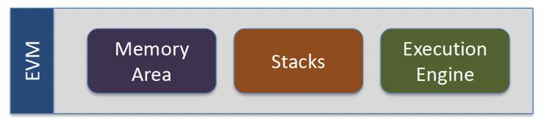
What is EVM
“Runtime environment for smart contracts in Ethereum”
It is sandboxed and isolated; meaning the code running inside EVM has no access to network, filesystem, or other process
It is a software that can execute Ethereum bytecode
Smart contracts executed in EVM have limited access to other smart contracts (yet vulnerabilities are still rampant)
Follows the EVM spec (Eth protocol)
Runs on a computer or server (in the node)
Implemented in multiple languages
Notes:
Runtime environment is software that implements an execution model. Popular runtimes include JVM (Java virtual machine), Node.js, CLR (Common Language Runtime), ART (Android Runtime) etc

Slide 4
EVM
Executes code of arbitrary algorithmic complexity
Smart contracts are compiled into bytecodes > EVM reads and executes
Developers create apps in familiar languages (Javascript, Python) that interact with smart contracts stored in ethereum, through transactions, which are executed by the EVM
EVM has low level operations defined as bytecodes, which is what smart contract are compiled to.
ADD, MUL, CREATE, BALANCE etc are some opcode representation of low level operations
Notes:
All nodes running the EVM = world computer
Bytecode = Ethereum specific binary format

Slide 5
Why EVM
Why is a Virtual Machine needed?
Anything that runs on a blockchain needs to be immutable and must have the ability to run through multiple nodes without compromising on its integrity.
To accomplish this, 3 things are needed:
Deterministic
Terminable
Isolated
Notes:
https://blockgeeks.com/guides/ethereum-gas-step-by-step-guide/
This is copy and pasted

Slide 6
Deterministic
A program is deterministic if it gives the same output to a given set of inputs every single time, from any number of computers.
When does a program act in an un-deterministic manner?
When calling un-deterministic system functions
Un-deterministic data resources: If a program acquires data during runtime and that data source is un-deterministic then the program becomes un-deterministic
Eg. Suppose a program that acquires the top 10 google searches of a particular query. The list may keep changing.
Dynamic Calls: When a program calls a second program it is called dynamic calling. Since the call target is determined only during execution, it is un-deterministic in nature
Example: 3+1 = 4
Any computation of 3 + 1 will = 4
Notes:
copypasta

Slide 7
Turing Completeness
Machine that can simulate any computer algorithm
Allows for loops, makes Ethereum vulnerable to halting problem
Cannot determine whether a program will run infinitely
System fees (gas) prevent this from occurring > protects network from malicious actors trying to put network in infinite loop
Notes:
What is turing complete? A computational system that can compute every Turing-computable function is called Turing-complete (or Turing-powerful). Alternatively, such a system is one that can simulate a universal Turing machine.

Slide 8

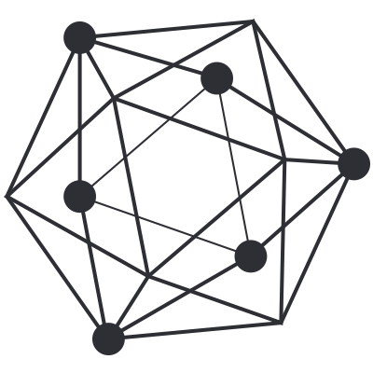
Terminable
Halting Problem: Unknowing whether or not a program can execute its function within a given time limit.
With smart contracts, there needs to be a way to externally “kill” the contract and to not enter into an endless loop which would drain network resources:
Step and Fee Meter: A program can simply keep track and limit the number “steps” it has taken
Fee-meter. Here the contracts are executed with a prepaid fee. Every instruction execution requires a particular amount of fee. If the fee spent exceeds the pre-paid fee then the contract is terminated.
Timer: Here a predetermined timer is kept. If the contract execution exceeds the time-limit then it is externally aborted.
Turing Incompleteness: A Turing Incomplete blockchain will have limited functionality and not be capable of making jumps and/or loops. Hence they can’t enter an endless loop.
Notes:
In mathematical logic, we have an error called “halting problem”. Basically, it states that there is an inability to know whether or not a given program can execute its function in a time limit.
In 1936, Alan Turing deduced, using Cantor’s Diagonal Problem, that there is no way to know whether a given program can finish in a time limit or not.
This is obviously a problem with smart contracts because, contracts by definition, must be capable of termination in a given time limit.
Step and Fee Meter, i.e. the number of instructions it has executed, and then terminate once a particular step count has been executed.

Slide 9
Isolated
In a public blockchain, anyone and everyone can upload a smart contract.
However, because of this the contracts may, knowingly and unknowingly contain virus and bugs.
If the contract is not isolated, it may have the ability to hamper the whole system.
Hence, it is critical for a contract to be kept isolated in a sandbox to save the entire ecosystem from any negative effects.
It is common in public blockchains to only allow certain functions to be called by contracts.

Slide 10
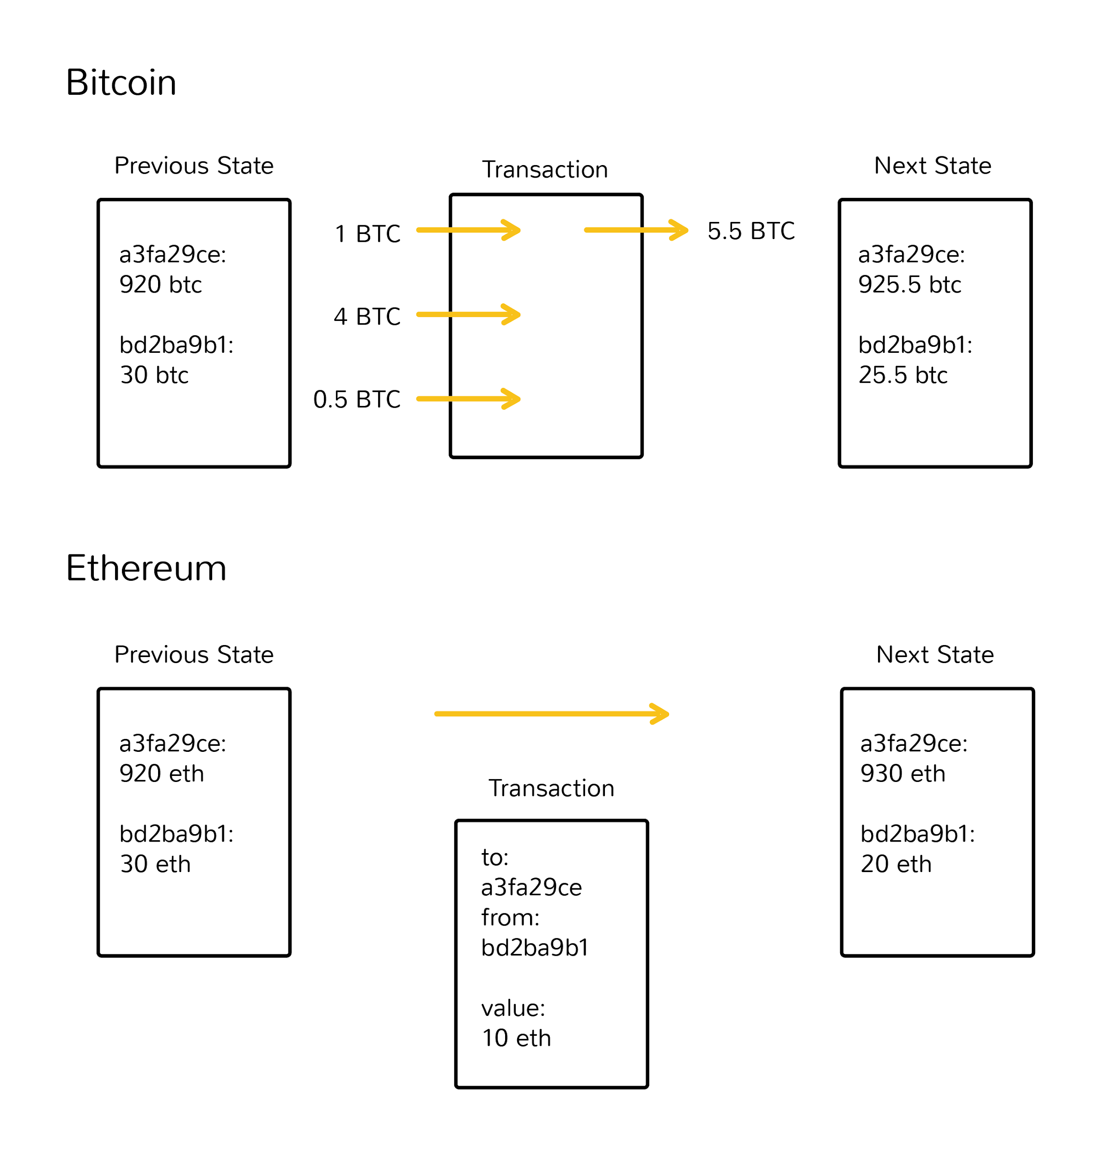
State
Network keeps track of ”state”:
State can be defined as the present condition of a program/application/database etc.
For ethereum, it is the current information for all applications and transactions, balances, etc.
Instead of transactions being the basic unit (bitcoin), Ethereum uses the account as the base unit

Slide 11
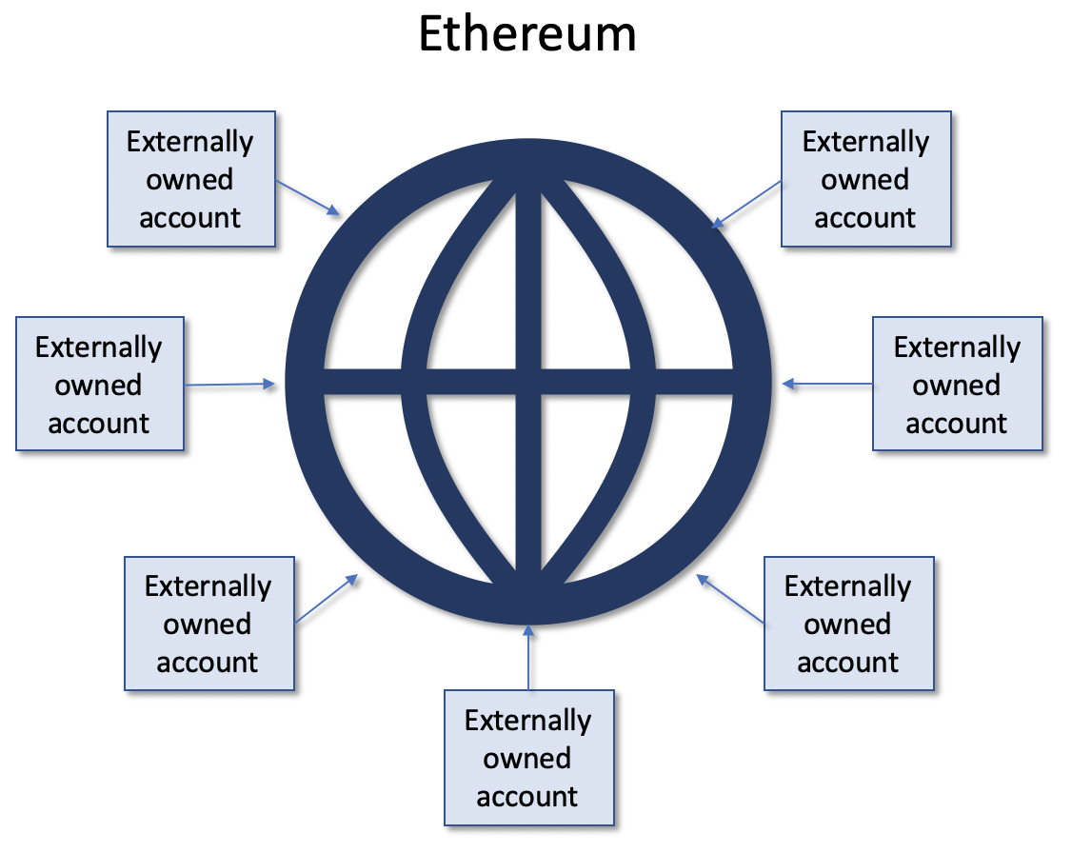
Accounts
Ethereum State = Contains millions of objects called “accounts” that have the ability to maintain an internal database, execute code and speak to each other
Notes:
- Can read/write to its own internal storage

Slide 12
Accounts
Global shared state of Ethereum is made of small objects (accounts)
Two types of accounts
EOA – externally owned account controlled by private key (no code associated)
Contract – account has its own code, and is controlled by it
Each account is uniquely identified by its 20-byte address
Notes:
Global shared state means, the state that every node have.
EOA – account controlled by a private key. Owners can send ether and messages from said account
Once execution stops, and all sub-executions triggered by a message sent by a contract stop (this all happens in a deterministic and synchronous order, ie. a sub-call completes fully before the parent call goes any further),
Upon execution halt, and all sub executions finish from a message sent by a contract stop in a deterministic and synchronous order (sub call complete fully before parent call proceeds)
An address in Ethereum is a 160 bit identifier that is used to identify the account

Slide 13

What does an account contain?
Nonce: count of the number of outbound transactions, starting with 0. for contract accounts it’s the number of contracts created by the account.
Balance: the amount of ether in the account.
StorageRoot: the hash associated with the storage of the account (root node of Merkle Patricia) empty by default. Stays empty for EOA.
CodeHash: the hash of the code governing the account. For contracts, it is the hash of the codebase, for EOA this field is the hash of the empty string “”
Externally owned account
Contract Account
<code>
<code>
<code>
nonce
balance
codeHash
storageRoot
nonce
balance
codeHash
storageRoot
Notes:
Why count outbound transactions? Security measure to ensure double transactions don’t occur

Slide 14
Accounts Transaction Process
Transaction set in motion by an externally owned account
Fired in response to the transaction set in motion by externally owned account
Execution environment is lifeless until external user triggers action and sets Ethereum in motion
EOA to EOA : transfer of funds
EOA to Contract: contract activates based on input and runs its code
Contract to Contract: send and receive messages to execute internal processes. Cannot initiative a transaction by themselves
Externally owned account
Contract Account
Internal Transaction
Contract Account
Transaction
Externally owned account
Externally owned account
Transaction
Any actions that occur on Ethereum are always set in motion from Externally Owned Accounts!

Slide 15
Accounts vs Wallet
Ethereum Account = has a private key and account address pair
Native to ethereum & resides in ethereum state
Private key can make transactions that proves ownership of the account using a digital signature
Does not require gas to create an account
Notes:
“Does not require gas to create an account” - Why do we say that ?. Think about this

Slide 16
Accounts vs Wallet
Ethereum wallet = software written for ethereum
Not native to ethereum
Interacts with a node (directly or indirectly)
Can be used to manage ethereum accounts
The software provides key management and other services

Slide 17
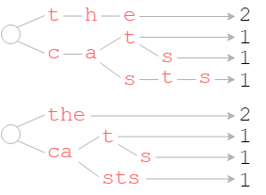
Merkle Patricia Trie vs Merkle Tree
Trie and Tree are used synonymously
Merkle Patricia Trie is just a more compact version of a Merkle Tree
The compact MPT (bottom) contains fewer nodes, as it decomposes keys only at points of difference.
Since storage is so expensive on Ethereum, this allows for more efficient use of data.
Notes:
https://nervous.io/clojure/crypto/2018/04/04/clojure-evm-iii/
Ethereum’s trie requires three distinct node types:
Branch — inserted at points where at least two keys diverge, each branch has a child slot for every possible nibble (0-15). Branches optionally contain a value, in the event a key terminates at the branch point.
Extension — holds a single, non-empty key (1 or more nibbles) and a single child. An extension can be thought of as a compaction of layers of redundant branch nodes.
Leaf — Similar to extensions, with the exception that leaves reference a value, rather than a child node, and may have empty keys.

Slide 18
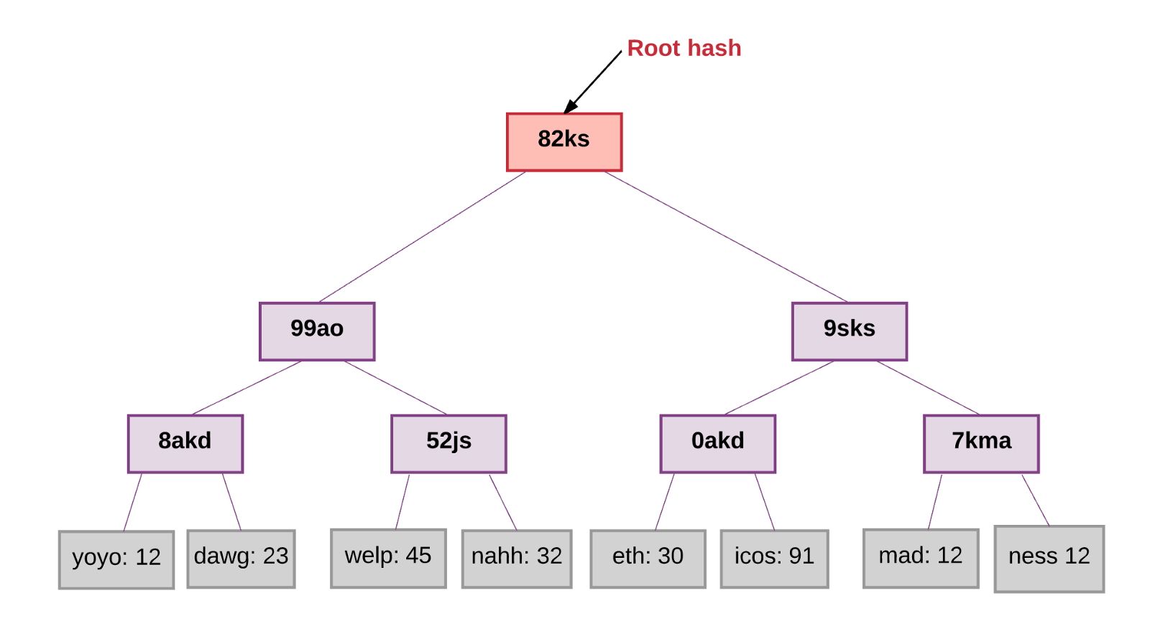
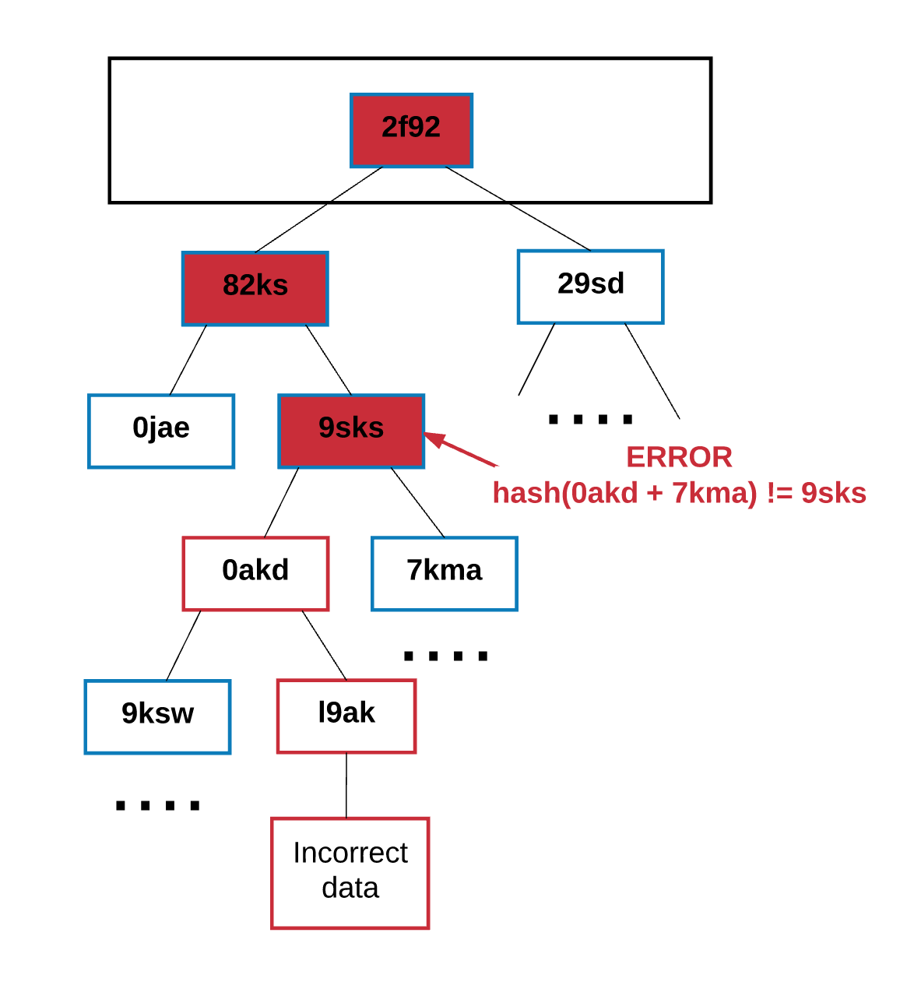
Ethereum World State
Global State = mapping between account addresses and its states
Stored in a Merkle Patricia Tree (data structure)
The leaf nodes are accounts and contains the details nonce, balance, storage root and code hash
Notes:
Merkle Tree = binary tree composed of a set of nodes with:
Large number of leaf notes at the bottom that contain the base data
Set of intermediate nodes (hash of two child nodes)
Single root node, from the hash of two intermediate nodes (top of tree)
Define chunks and buckets

Slide 19
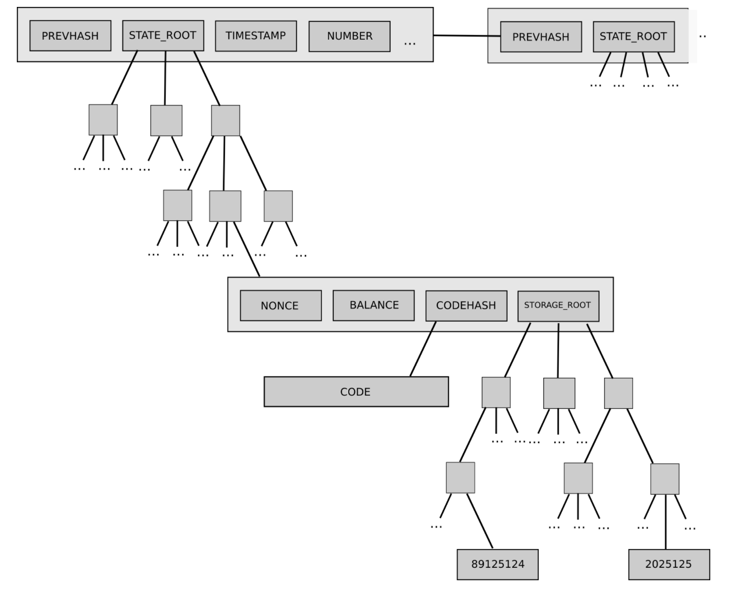
Ethereum World State … Cont’d
Key is required for each value stored within tree
Starting from root node, key tells which child node to follow to get the corresponding value, which is stored in the leaf node
Key/value mapping for state tree is between addresses and their accounts (including 4 aspects we described earlier)
Storageroot is root of a tree in itself
Notes:
Need to show examples of this and the other data structures with actual code

Slide 20
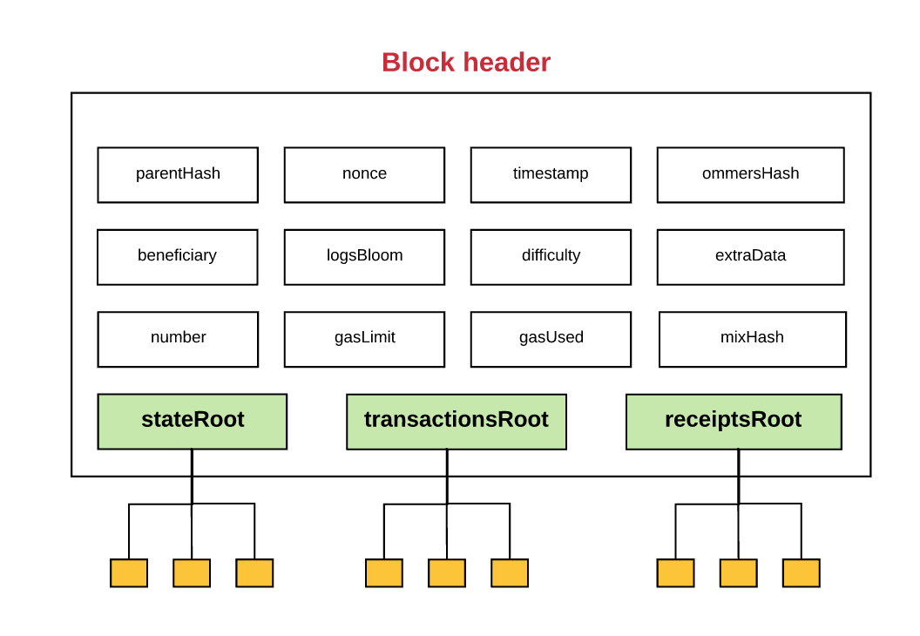
Ethereum World State … Cont’d
Same structure is used to store transactions and receipts
Every block has a header – stores hash of root node of three different merkle trees including (state trie, transactions trie, receipts trie)
Notes:
Ability to store all this information efficiently within merkle trees is very useful to light clients operation

Slide 21
Ethereum Block
Notes:
Ability to store all this information efficiently within merkle trees is very useful to light clients operation

Slide 22
Ether (ETH)
Native currency of ethereum, used to pay the computational resources needed to run an app on the decentralized network
Digital bearer asset
Not a security, although it ICO’d
Ex. taxi cab badges
Used to read/write to Ethereum, known as digital “oil”
Costs are based on computational requirements
Notes:
Digital Bearer Asset: similar to a security or bond / issued in physical form
No limit to max ETH in the world (opposed to 21m bitcoin)
60m purchased by users in 2014 crowdfund
12m to Ethereum foundation
Every 12s , 5 eth are mined (to change soon with casper) = 18m at most per year (verify)
Uncles as mining reward

Slide 23
Gas
Gas is the resource we need, to do payment transactions/run smart contract code/store data etc in ethereum
Gas cost for each single operation is fixed (as part of the ethereum protocol, and changed as part of improvements)
We need to “buy” gas (indirectly), when making transactions, using ether.
Txn fee (payed in ether) = total gas required * gas price

Slide 24

Gas Prices
Gas price is dynamic – subject to market conditions
Measure of how badly user wants to pay per gas.
Gas price is specified in Gwei/gas
(1 Gwei = 0.0000000001 ETH)
These fees are paid out to the miner
Miners prioritize higher gas prices first
(they make more money)
Processing
Transaction
…
…
Start Gas
(units)
Gas Price
(u Ethers)
Escrow:
startGas*gasPrice
gasUsed:
summed cost of executed instructions
gasPrice:
User specified amount
Actual Fee Paid:
gasUsed*gasPrice
Initial Fee Paid:
startGas*gasPrice
Refund:
(startGas - gasUsed)*gasPrice
Out of gas exception
No changes made

Slide 25
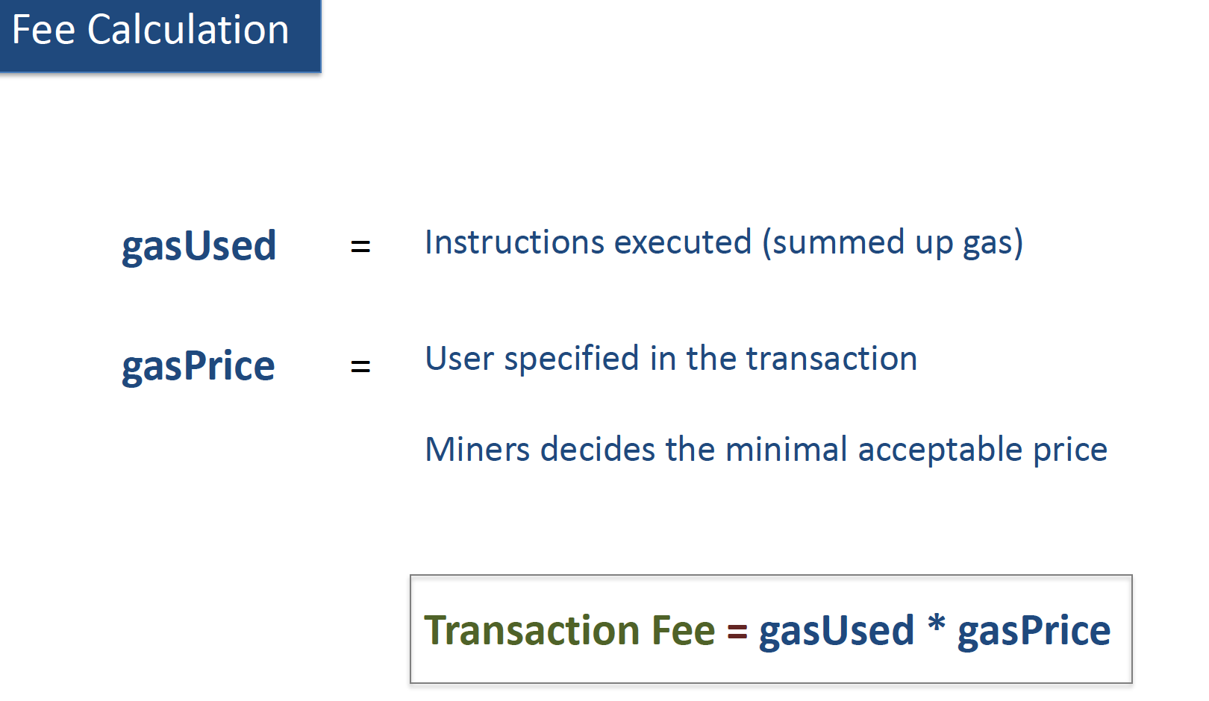
Calculating Gas Costs
OPCODES = low level operation in EVM
Ex. ADD – add two integers (3 gas)
BALANCE – pull balance of an account
CREATE – creates a new contract
MUL – multiply two integers (5 gas)
Each has a gas costs associated in order to function
All transactions cost 21000 gas as a base
Gas OPCodes and cost: https://github.com/djrtwo/evm-opcode-gas-costs
Notes:
MuL is more complex, thus requires more gas
Even if just transferring funds, and not interacting with a contract, the base gas cost is 21000 gas. Interaction just adds to this minimum
Reading values from the blockchain does not incur a gas cost

Slide 26
Wei
“Wei” is the smallest unit of Ether, where 10¹⁸ Wei represents 1 Ether. One gwei is 1,000,000,000 Wei.
Gas Limit * Gas Price = Max Transaction Fee
When Gas Fee Is calculated, user must have enough ETH in acct to cover the max. when the actual transaction happens, user is refunded the difference.
Use gas -50
Use gas -30
Sender
Start Transaction
Operation1
Operation2
End Transaction
Receiver
250
200
170
170
Start gas
Remaining gas
Notes:
Redundant, should know what Wei is by now

Slide 27

Running out of Gas
If the sender does not provide necessary gas to execute the transaction, it will run out of gas and be rendered invalid
State reverses to before transaction occurred (all changes reversed)
Failing record gets recorded that attempt happened and where it failed
Since work was done, gas is consumed and NOT REFUNDED
Sender
Start Transaction
Operation
Operation
Operation
Operation
Receiver
250
Use gas
Use gas
Use gas
OUT OF GAS
Revert State
0
Start gas

Slide 28
Running out of Gas … Cont’d
Gas consumed goes to the Miner, since they were the ones doing the work validating the transaction
Miner
Sender
Start Transaction
Use gas -50
Operation
Use gas -30
Operation
End Transaction
Receiver
250
200
170
170
Start gas
Remaining gas

Slide 29

Current Status (Mainnet)
Eth Gas station
High level costs: spreadsheet
ETH Converter: https://converter.murkin.me/
Transaction
Instructions
ADD
MUL
JMP
...
Execution
Storage
Fee paid by originator
Type/Number of Instructions
Amount of storage
Notes:
Explain the Process

Slide 30
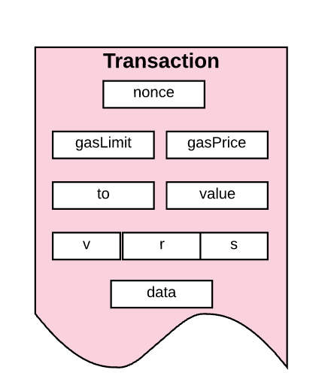
Transactions and Messages
Transaction = cryptographically signed instructions generated by EOA
It is then serialized and submitted to the Ethereum blockchain
Two types: message calls and contract creation
Message calls: when “data” or “value” is passed between accounts
Txn has same data structure regardless of the type
Nonce
Gas Price
Gas Limit
To
Value
v,r,s
Init
Data
init
Notes:
Review that Ethereum is a transaction-based state machine
Basically, transactions are what create state changes in the EVM
EOA - externally owned account
Nonce: count of the number of transactions sent by sender
gasPrice: Wei (quantity) sender willing to pay per unit of gas to execute transaction
gasLimit: max gas sender willing to pay for executing transaction. Set and paid upfront before any work done
To: Recipient address. For a contract creating transaction, the contract address doesn’t exist so this is blank
Value: amount of Wei to be transferred from sender to receiver. In a contract generating transaction, it is the starting balance within the new contract account
V,r,s: generates the signature for sender’s identity
Init: only exists for contract creating transactions. EVM code fragment that is used to initialize new contract account. Runs only once, then is discarded. When run, it returns the body of the account code which is permanently associated with the contract account.
Data: optional field only for message calls. This is where the input message field data goes. Example: smart contract that serves as a domain registration service, a call to that contract might need ”domain” and “IP” fields.

Slide 31
Contract to Contract Messages
Communicate via “internal transactions”
Not generated by EOA
Virtual objects – not serialized and exist only with Ethereum
Internal transactions do not contain a gas limit
Gas Limit helps prevent undetermined amounts of contract to contract execution.
That can get expensive!
Externally owned account
Contract Account
(contract code gets executed)
Transaction
Internal Transaction
Externally owned account
Contract Account
Contract Account
Contract Account
Transaction
Internal Transaction
Internal Transaction
(contract code gets executed)
(contract code gets executed)
(contract code gets executed)
Notes:
When one contract sends an internal transaction to another – the code executes until the final state.
No gas limit because it is determined by the external creator of the original transaction (EOA)
Onset gasLimit must cover any and all sub executions that occur as a result of the initial transaction (including contract to contract)
If it runs out of gas midway through, the message’s execution will revert along with any subsequent messages triggered.
The parent execution does not need to revert

Slide 32
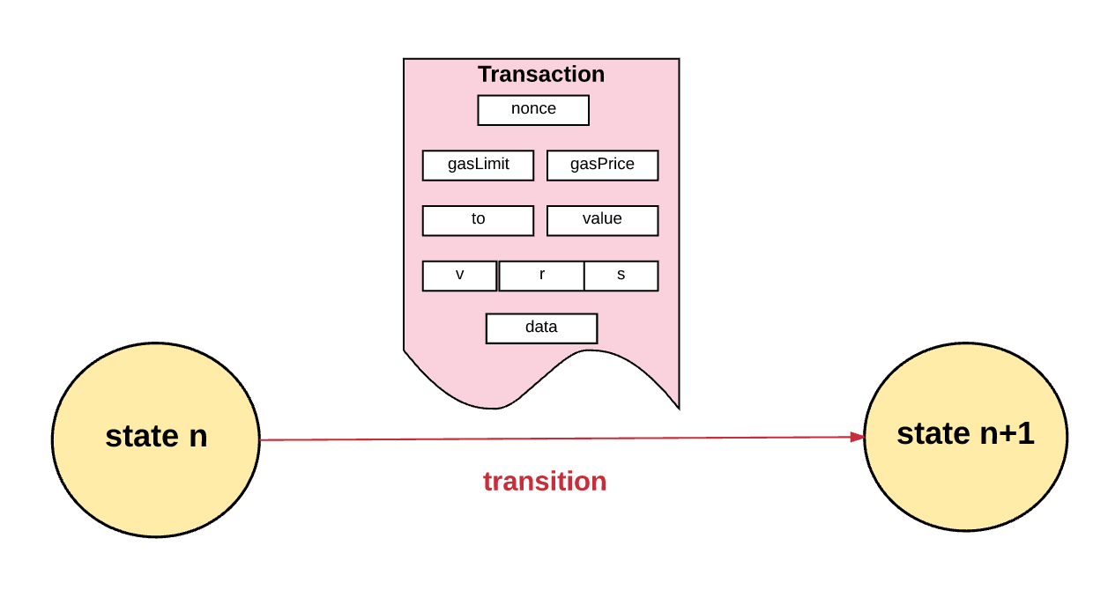
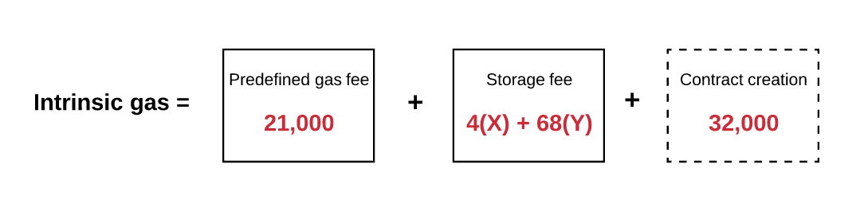
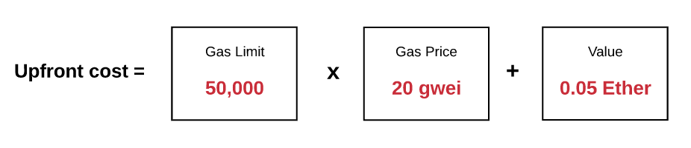
Transaction Execution - Validity
Must meet initial set of requirements in order to be executed
RLP format = Recursive Length Prefix
Valid transaction Signature
Valid Transaction Nonce
Gas Limit >= Intrinsic Gas Used
Sender’s Account Balance covers Upfront gas cost
Notes:
RLP = data format used to encode nested arrays of binary data. This is the format Ethereum uses to serialize objects. Check handout for link for more information. It is going to be replaced eventually for a more preferable form of serialization.
Recall: nonce of an account is the count of transactions sent from that account. For validity, nonce must equal sender’s account nonce
Diagram explanation: Gas Used minimum of 21,000 + fee for data sent (4 gas for every byte of data/code that equals 0, 68 gas for every non-zero byte of data/code) + 32,000 if transaction is to create a contract
Diagram explanation: gas limit * gas price + value transferred

Slide 33
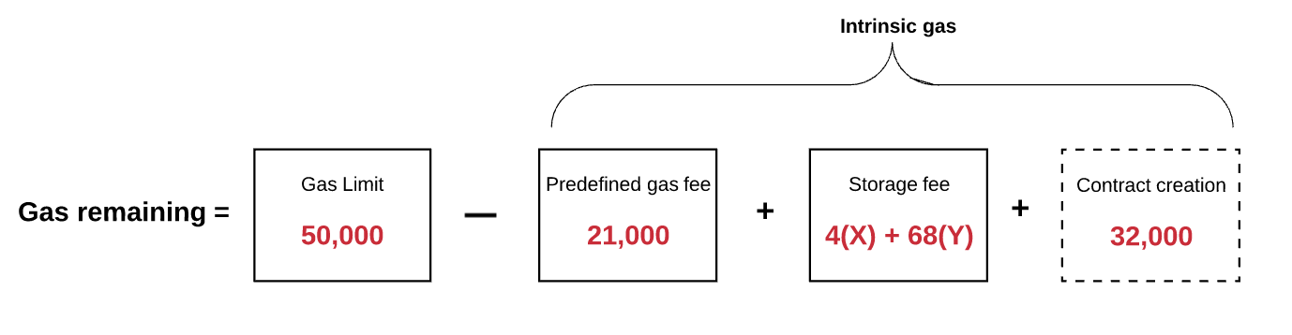
Transaction Execution process - Message Calls
Upfront execution cost deducted from account
Nonce increases by 1
Remaining Gas Calculated
Execution: Transactional Computations
State Finalized (pending no invalid)
Unused gas refunded to sender + refund balance
Gas consumed given out to miner
Gas used added to block gas counter
All accounts in self destruct are deleted
Final State Reached and logs created for transaction
Substate:
Self Destruct Test
Log Series
Refund Balance
Notes:
Note: Remaining gas calculated as the total gas limit for the transaction minus intrinsic gas used.
During execution, Ethereum keeps track of the “substate”
Self Destruct Test: set of accounts (if any) that will be discarded after transaction completes
Log Series: archived/indexed checkpoints of EVM code execution
Refund balance: Amount to be refunded to sender after transaction using a Refund counter that starts at 0 and increases as entries are removed.
Recall: transactions take up storage and users are rewarded for freeing up storage. This is where the “ reward “ kicks in.
Gas used counter is useful when validating the completed block

Slide 34
Transaction Execution process - Contract Creation
New Contract Address Generated
Set nonce to zero
Ether value added to this new account balance, deducted from sender’s balance
Set storage as empty
Set contract’s codeHash as the hash of an empty string
Account initialized; init code command used to create contract account
Constructor executed
Codehash is set
If successful, a final contract creation cost is paid
Unspent Gas refunded; achieve final state
Notes:
Depending on what the constructor does, this could include creating more accounts, updating storage, make calls, etc.
Reminder: there must be sufficient gas in order to execute all work until final state reached, or state will roll back with OOG (out of gas) exception, before transaction occurred. No refund for consumed gas, but any Ether sent will be refunded.
Define constructor - Constructor is special method of an object that initializes it when it is newly created

Slide 35
Message calls vs Contract creation
Message Calls have:
No init code
May contain input data (if provided by sender)
After execution: contain output information
Notes:
No init code as no new account created
The output information may be used by another contract if built in

Slide 36
EVM - Memory, storage and the Stack
The part of the protocol that handles processing (EVM)
Stack based architecture: stack item size is 256 bit, stack max size 1024
EVM has memory: items stored as word addressed byte arrays; volatile
EVM has storage: non volatile, maintained as part of state
Program code stored separately, in virtual ROM
EVM
Code
Storage
[[<addr>]]
ROM
RAM
@@<addr>
non-volatile
args
memory
[<addr>]
stack
@<addr>
Calldataloaded <byte>
ROM
RAM
volatile

Slide 37
Storage
Fees for storage as well. Total fee is proportional to the smallest multiple of 32 bytes used
Increased storage increases the size of Ethereum state database on all nodes, therefore there is incentive to keep the data stored small
Thus, if a transaction has a step that clears an entry in the storage, fee for executing that operation is waived and a refund is given for freeing up space

Slide 38
Transaction Lifecycle
Create transaction with appropriate values/data
Sign transaction with private key
Send transaction to node
Transaction is verified & propagated to the network
Transaction gets picked up by miner & put in block
Block is broadcasted to the network
Block is added by other nodes to their chain

Slide 39
Transaction execution
Transaction executions happens in a node :
When a is node is trying to create a candidate block, by picking transaction from pool and executing it
A node receives a block and verifies the transactions by executing it, before adding the block to the blockchain

Slide 40
Execution: System State
EVM checks that the following information is available and valid:
System state (the global state)
Remaining gas for computation
Account address of executed code owner
Account address of sender
Address of account that caused the code to execute (could be different than original sender)
Gas price of the transaction that originated execution
Input data for execution
Value (in Wei) passed to this account as part of current execution
Machine code to be executed
Block header of current block
Depth of present message call or contract creation stack
Notes:
@ start of execution memory and stack are empty and counter is zero

Slide 41
Execution 2: Transaction Execution
EVM then executes transaction recursively
Computes system state and machine state (state of current execution), for each loop
Each cycle, gas reduced from remaining gas and the program counter increments
3 options at end of loop:
Exception state
Process continues to next state
Process finishes and reaches end state
Notes:
System state = Ethereum’s global state
Machine state = gas available, program counter, memory contents, active number of words in memory, stack contents
Exception state – insufficient gas, invalid instructions, insufficient stack items, overflow over 1024, etc. Changes are discarded

Slide 42
Finalizing Blocks
Requirements:
Validate Ommers/Uncles
Validate transactions
Apply Rewards (only if mining)
Verify State and Nonce
New = block is mined
Existing = block is validated
Notes:
Validate Uncles – each O/U within block header must be a valid header and within 6th generation of the present block
Validate Transactions – gasUsed must equal sum of gas used by all transactions in block through the block gas counter
Apply Rewards – miner is awarded 5 ETH. For each Ommer included, miner is rewarded 1/32 the current block reward
Extra Note: EIP-649 in Further readings will reduce the number from 5 to 3 in order to prep for Casper.

Slide 43
THANK YOU
QUESTIONS ?
Notes:
Validate Uncles – each O/U within block header must be a valid header and within 6th generation of the present block
Validate Transactions – gasUsed must equal sum of gas used by all transactions in block through the block gas counter
Apply Rewards – miner is awarded 5 ETH. For each Ommer included, miner is rewarded 1/32 the current block reward
Extra Note: EIP-649 in Further readings will reduce the number from 5 to 3 in order to prep for Casper.

